Slide 1
Upgrade your .NET code! From C# 7.0 to C# 8.0 walkthrough
Wrocław, 14.03.2019, Tomasz Strzałka

Slide 2
Agenda
We are going to talk about…
Introduction
The recent C# versions timeline,
C# 8.0 pre-requirements,
dive into an example.
What’s new in C# 7.1
Async Main method,
default literal expressions,
inferred tuple element names.
What’s new in C# 7.2
Safe efficient code enhancements,
non-trailing named arguments,
leading underscores in numeric literals,
private protected access modifier,
conditional ref expressions.
Introduction
The recent C# versions timeline,
C# 8.0 pre-requirements,
dive into an example.
What’s new in C# 7.1
Async Main method,
default literal expressions,
inferred tuple element names.
What’s new in C# 7.2
Safe efficient code enhancements,
non-trailing named arguments,
leading underscores in numeric literals,
private protected access modifier,
conditional ref expressions.

Slide 3
Agenda
We are going to talk about…
What’s new in C# 7.3
Enabling more efficient safe code,
fixed fields without pinning access,
local ref variables reassignment,
array initializers with stackalloc,
extended fixed support for types,
enhanced generic constraints.
Make existing features better
equality comparator tuple support,
field attributes for auto-implemented properties,
in method overload,
extend expression variables in initializers.
What’s new in C# 7.3
Enabling more efficient safe code,
fixed fields without pinning access,
local ref variables reassignment,
array initializers with stackalloc,
extended fixed support for types,
enhanced generic constraints.
Make existing features better
equality comparator tuple support,
field attributes for auto-implemented properties,
in method overload,
extend expression variables in initializers.

Slide 4
Agenda
We are going to talk about…
What’s new in C# 8.0
Nullable reference types,
async streams,
ranges and indices,
default interface members,
recursive patterns,
switch expressions,
target-typed new-expressions,
extension everything,
using declarations.
What’s new in C# 8.0
Nullable reference types,
async streams,
ranges and indices,
default interface members,
recursive patterns,
switch expressions,
target-typed new-expressions,
extension everything,
using declarations.

Slide 5
Introduction
The recent C# versions timeline

Slide 6
Agenda
We are going to talk about…
Introduction
The recent C# versions timeline,
C# 8.0 pre-requirements,
Introduction
The recent C# versions timeline,
C# 8.0 pre-requirements,
dive into an example.

Slide 7




The recent C# versions timeline C# 8.0 pre-requirements
1
Overlook to the few past releases
 | C# 7.0 | C# 7.1 | C# 7.2 | C# 7.3 | C# 8.0
 | March, 2017 | August, 2017 | November, 2017 | May, 2018
 | .NET Framework 4.6.2 | .NET Framework 4.7 | .NET Framework 4.7.1 | .NET Framework 4.7.2 | .NET Framework 4.8
 | .NET Core 2.0 | .NET Core 2.0 | .NET Core 2.0 | .NET Core 2.1 | .NET Core 3.0
 | .NET Standard 2.0 | .NET Standard 2.0 | .NET Standard 2.0 | .NET Standard 2.0 | .NET Standard 2.0/ .NET Standard 2.1
 | Visual Studio 2017 | Visual Studio 2017 v15.3 | Visual Studio 2017 v15.5 | Visual Studio 2017 v15.7 | Visual Studio 2019
Notes:
https://docs.microsoft.com/pl-pl/dotnet/csharp/whats-new/csharp-version-history https://en.wikipedia.org/wiki/C_Sharp_(programming_language)

Slide 8
Agenda
We are going to talk about…
Introduction
The recent C# versions timeline,
C# 8.0 pre-requirements,
dive into an example.
Introduction
The recent C# versions timeline,
C# 8.0 pre-requirements,
dive into an example.

Slide 9
Dive into an example
2
How things will goanna to work here
Pre-requirement software
Microsoft Visual Studio Enterprise 2019 Preview Version 16.0.0 Preview 2.2,
Microsoft .NET Core SDK 3.0.100.010184.
Visual Studio solution structure
00.Example,
#region C#7.0 Example,
#region C#7.1 Example,
#define _02_CSharp71_EXAMPLE_Question
…
…
01.AsyncMain,
…
Pre-requirement software
Microsoft Visual Studio Enterprise 2019 Preview Version 16.0.0 Preview 4.0,
Microsoft .NET Core SDK 3.0.100-preview4-010391.
Visual Studio solution structure
00.Example,
#region C#7.0 Example,
#region C#7.1 Example,
#define _02_CSharp71_EXAMPLE_Question
…
…
01.AsyncMain,
…

Slide 10
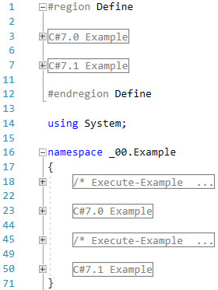
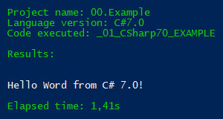
Example
3
C# 7.0 Hello Word

Slide 11
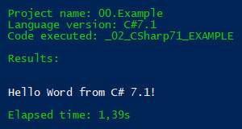
Example
4
C# 7.1 Hello Word

Slide 12
What’s new in C# 7.1

Slide 13
Agenda
We are going to talk about…
Introduction
The recent C# versions timeline,
C# 8.0 pre-requirements,
dive into an example.
What’s new in C# 7.1
Async Main method,
Introduction
The recent C# versions timeline,
C# 8.0 pre-requirements,
dive into an example.
What’s new in C# 7.1
Async Main method,
default literal expressions,
inferred tuple element names.
What’s new in C# 7.2
Safe efficient code enhancements,
non-trailing named arguments,
leading underscores in numeric literals,
private protected access modifier,
conditional ref expressions.

Slide 14
What’s new in C# 7.1
Async Main method

Slide 15
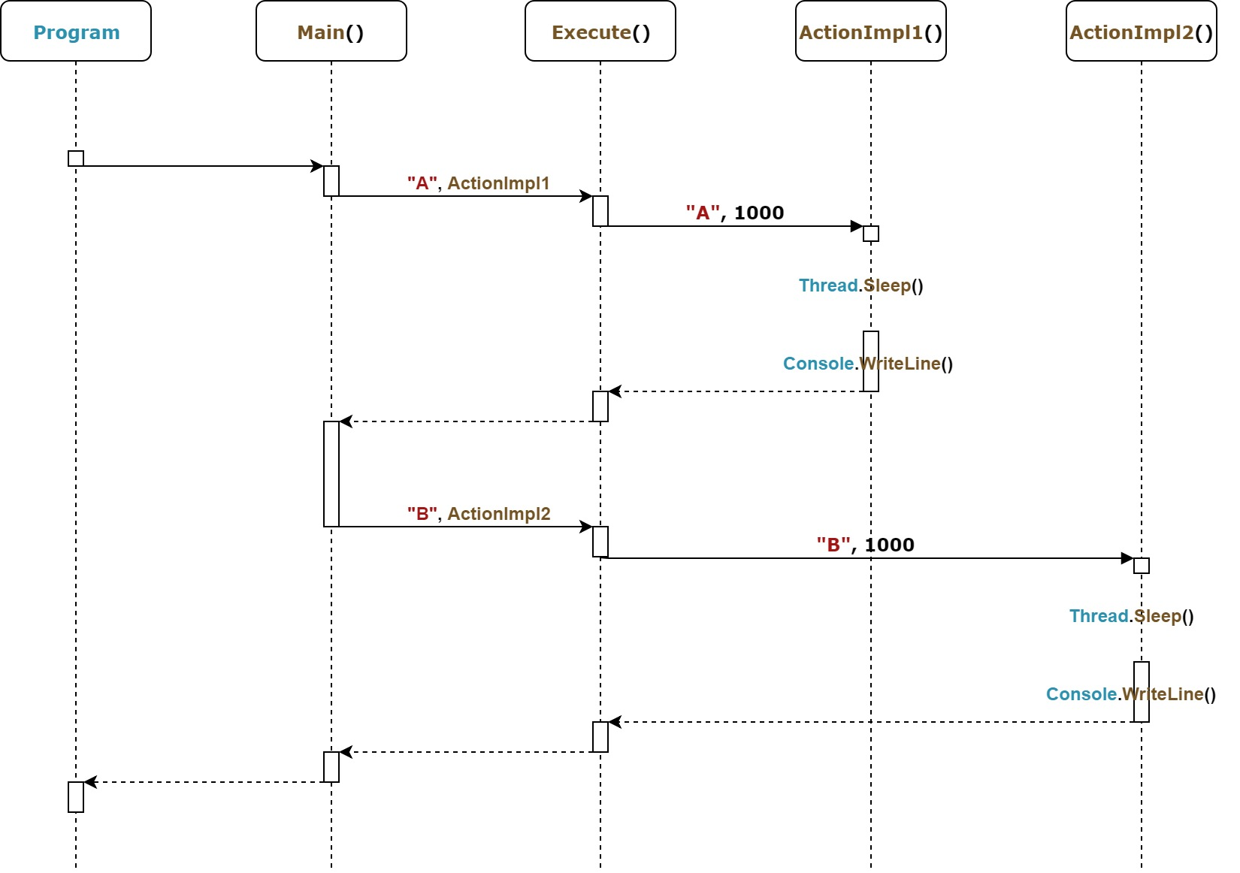
Async Main method
1
C# 7.0, totally synchronous, old fashioned way

Slide 16
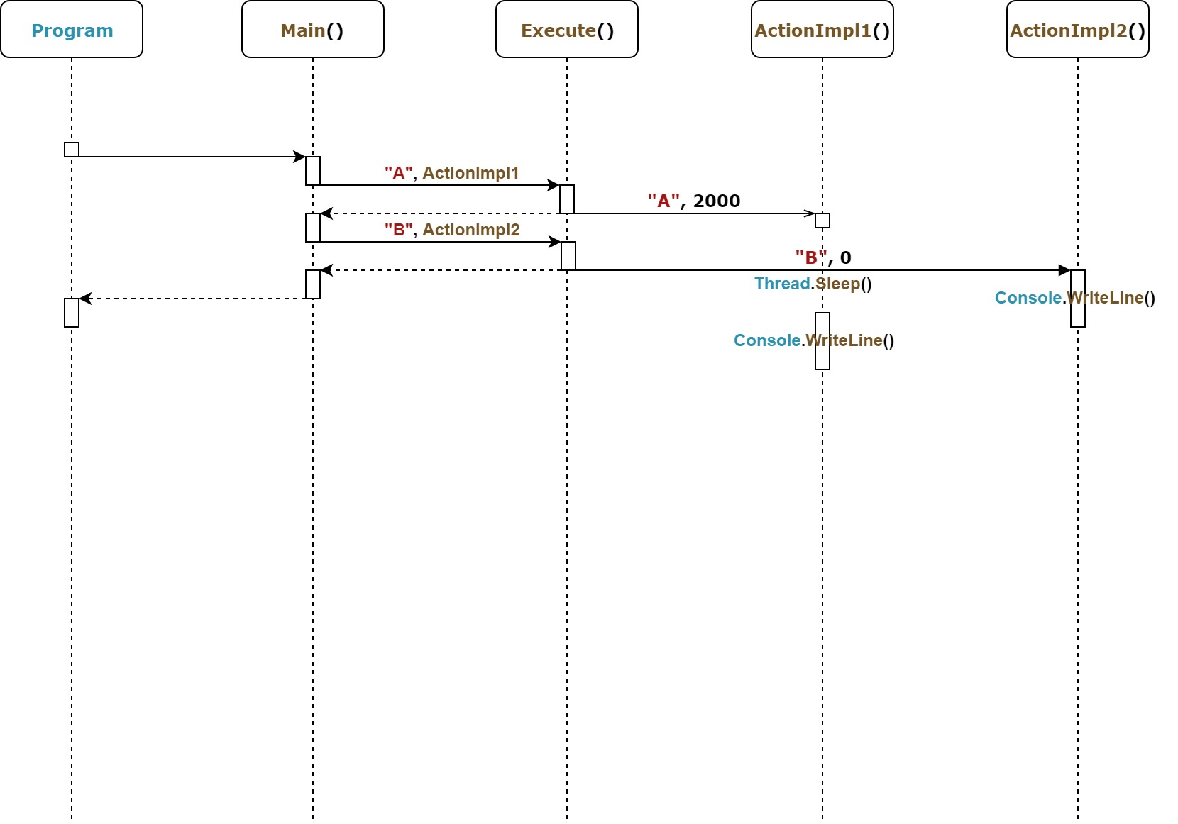
Async Main method
2
C# 7.0, asynchronous, Tasks

Slide 17
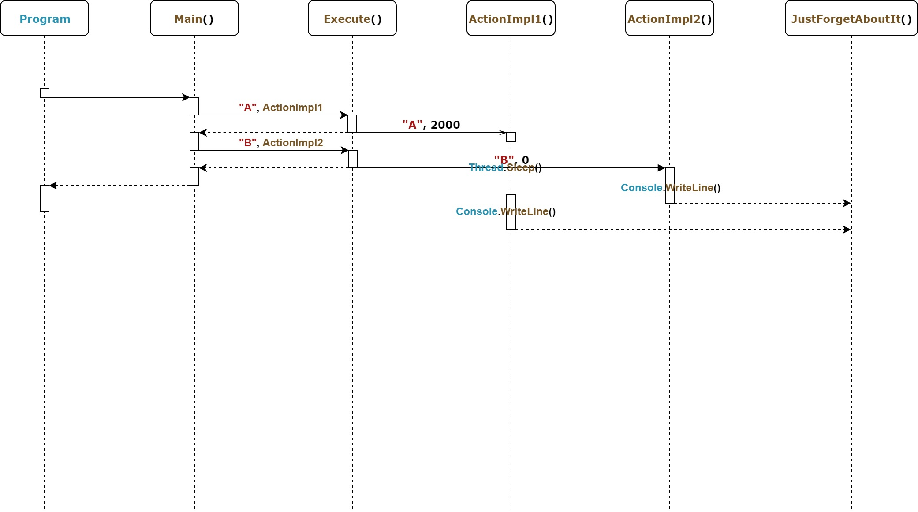
Async Main method
3
C# 7.0, async

Slide 18
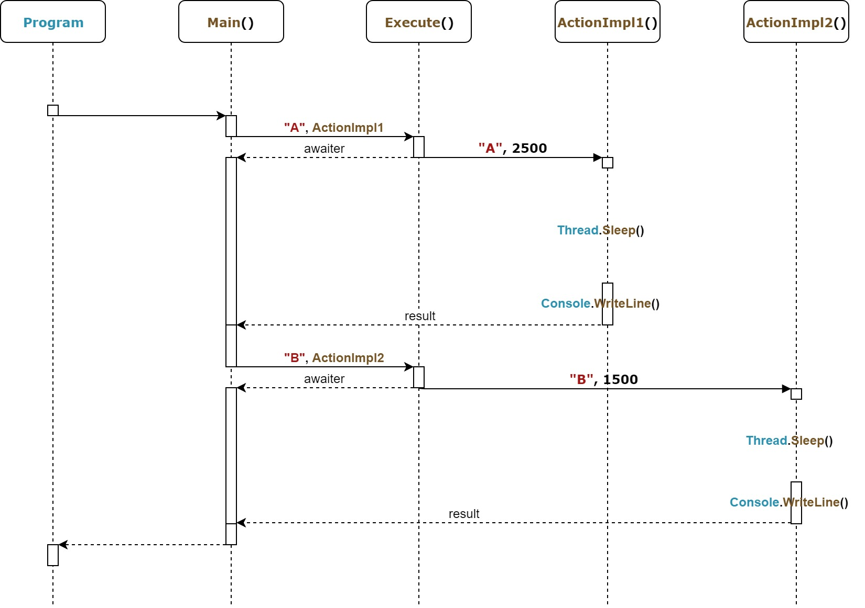
Async Main method
4
C# 7.0, async, awaiter

Slide 19
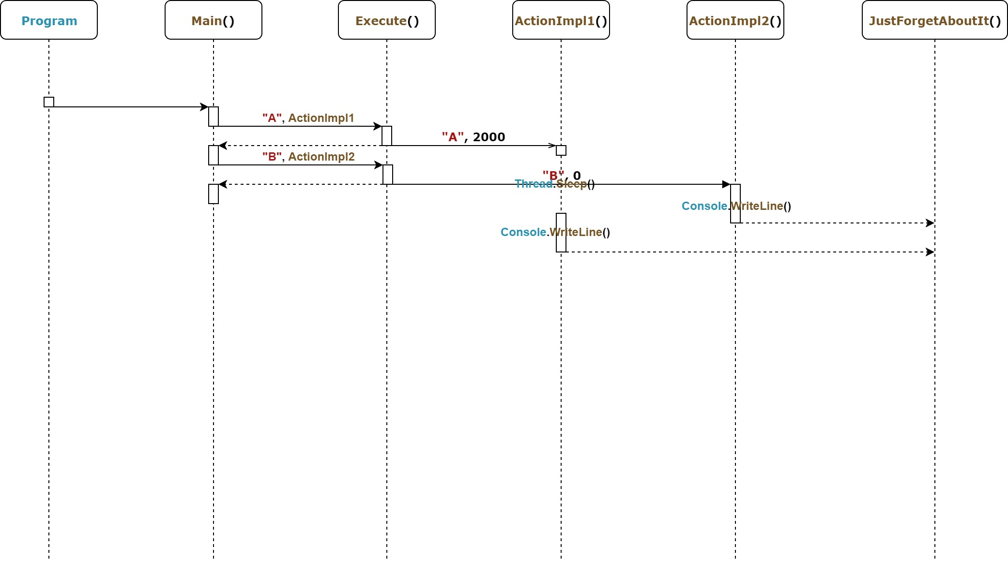
Async Main method
5
C# 7.1, async

Slide 20
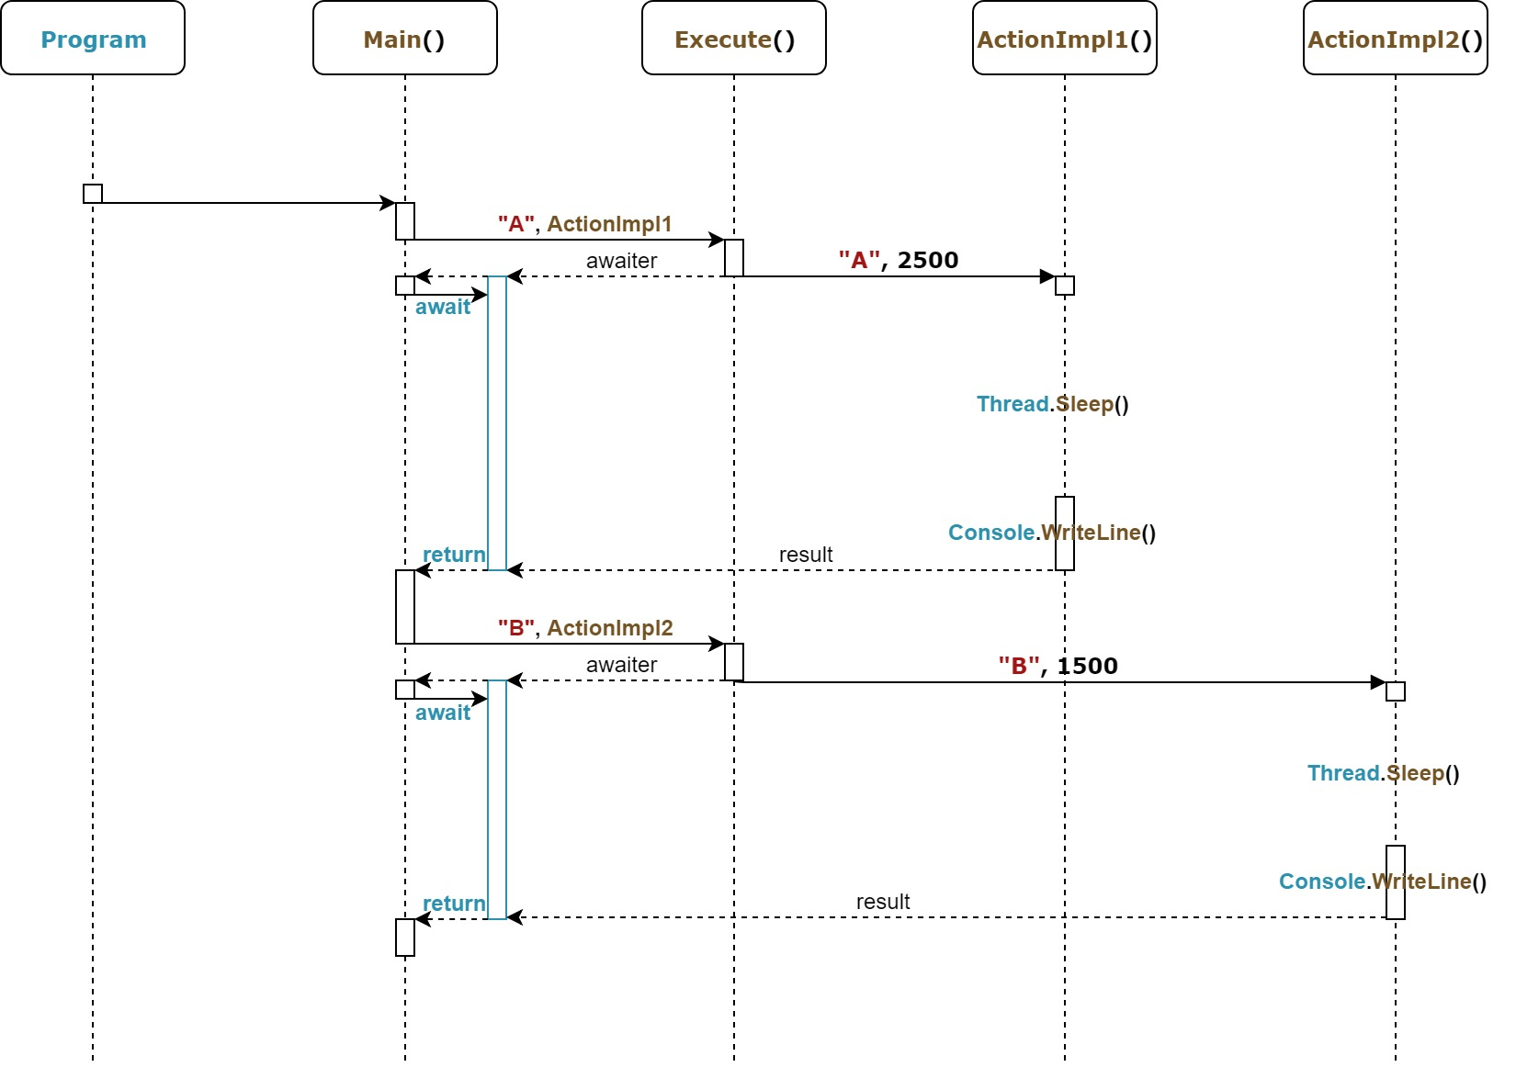
Async Main method
6
C# 7.1, async-await

Slide 21
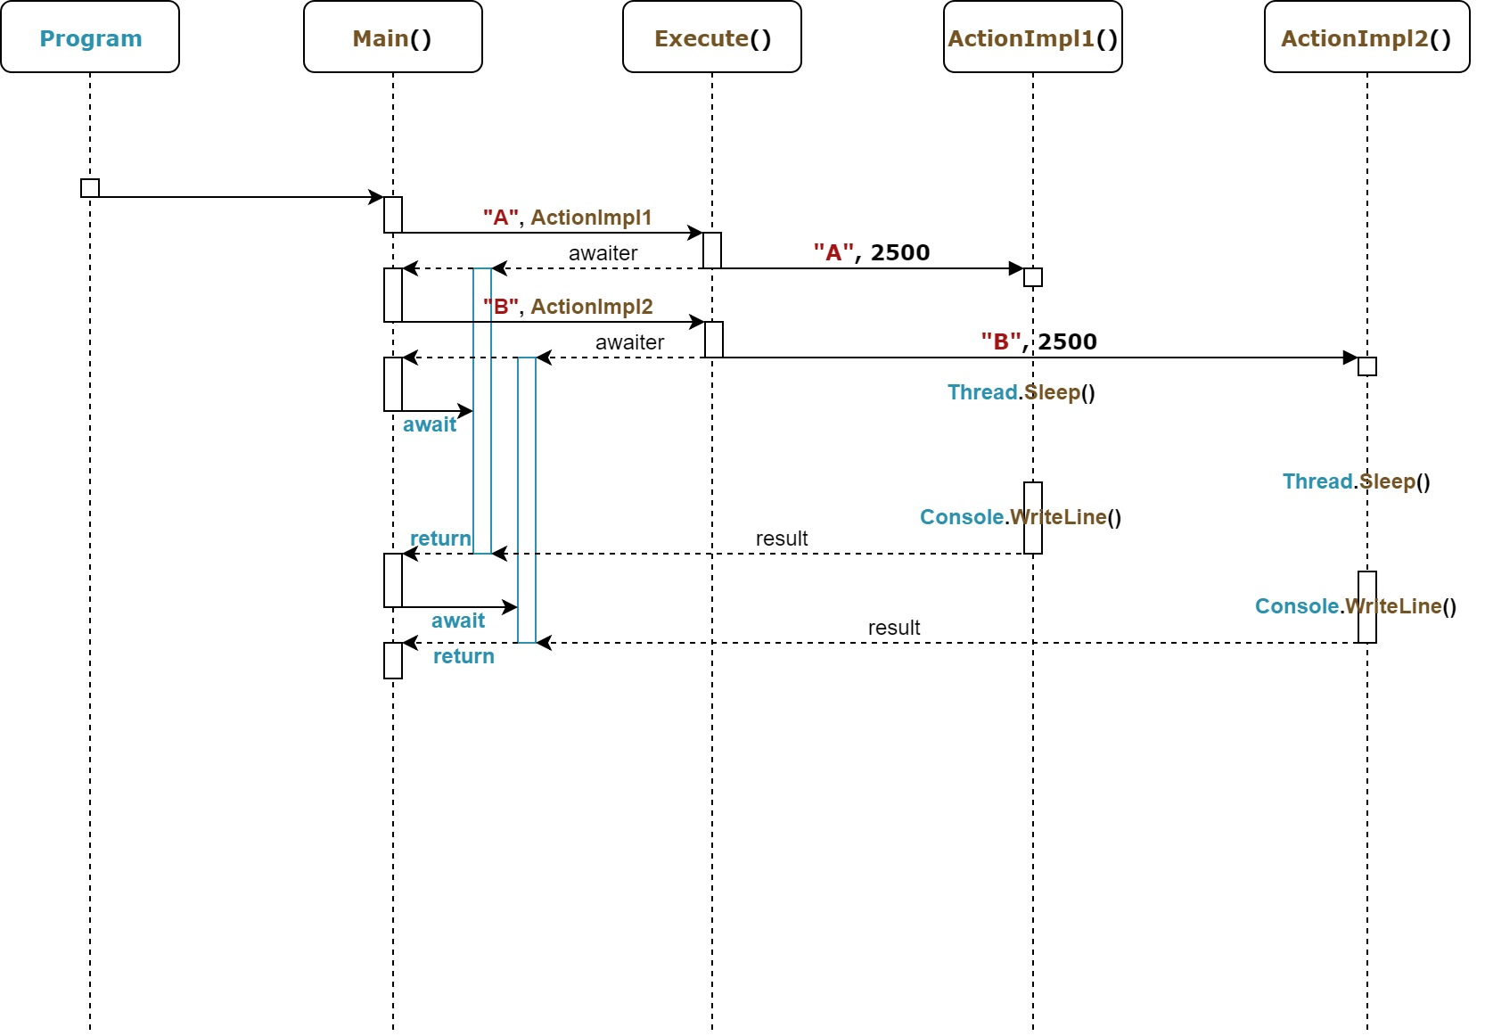
Async Main method
7
C# 7.1, async, await

Slide 22
Agenda
We are going to talk about…
Introduction
The recent C# versions timeline,
C# 8.0 pre-requirements,
dive into an example.
What’s new in C# 7.1
Async Main method,
default literal expressions,
Introduction
The recent C# versions timeline,
C# 8.0 pre-requirements,
dive into an example.
What’s new in C# 7.1
Async Main method,
default literal expressions,
inferred tuple element names.
What’s new in C# 7.2
Safe efficient code enhancements,
non-trailing named arguments,
leading underscores in numeric literals,
private protected access modifier,
conditional ref expressions.

Slide 23
What’s new in C# 7.1
Default literal expressions

Slide 24
Default literal expressions
1
C# 7.0

Slide 25
Default literal expressions
2
C# 7.1

Slide 26
Agenda
We are going to talk about…
Introduction
The recent C# versions timeline,
C# 8.0 pre-requirements,
dive into an example.
What’s new in C# 7.1
Async Main method,
default literal expressions,
inferred tuple element names.
Introduction
The recent C# versions timeline,
C# 8.0 pre-requirements,
dive into an example.
What’s new in C# 7.1
Async Main method,
default literal expressions,
inferred tuple element names.
What’s new in C# 7.2
Safe efficient code enhancements,
non-trailing named arguments,
leading underscores in numeric literals,
private protected access modifier,
conditional ref expressions.

Slide 27
What’s new in C# 7.1
Inferred tuple element names

Slide 28
Inferred tuple element names
1
C# 7.0

Slide 29
Inferred tuple element names
2
C# 7.1

Slide 30
What’s new in C# 7.2

Slide 31
Agenda
We are going to talk about…
Introduction
The recent C# versions timeline,
C# 8.0 pre-requirements,
dive into an example.
What’s new in C# 7.1
Async Main method,
default literal expressions,
inferred tuple element names.
What’s new in C# 7.2
Safe efficient code enhancements,
Introduction
The recent C# versions timeline,
C# 8.0 pre-requirements,
dive into an example.
What’s new in C# 7.1
Async Main method,
default literal expressions,
inferred tuple element names.
What’s new in C# 7.2
Safe efficient code enhancements,
non-trailing named arguments,
leading underscores in numeric literals,
private protected access modifier,
conditional ref expressions.

Slide 32
What’s new in C# 7.2
Safe efficient code enhancements

Slide 33
Safe efficient code enhancements
1
C# 7.1

Slide 34
Safe efficient code enhancements
2
C# 7.2

Slide 35
Agenda
We are going to talk about…
Introduction
The recent C# versions timeline,
C# 8.0 pre-requirements,
dive into an example.
What’s new in C# 7.1
Async Main method,
default literal expressions,
inferred tuple element names.
What’s new in C# 7.2
Safe efficient code enhancements,
non-trailing named arguments,
Introduction
The recent C# versions timeline,
C# 8.0 pre-requirements,
dive into an example.
What’s new in C# 7.1
Async Main method,
default literal expressions,
inferred tuple element names.
What’s new in C# 7.2
Safe efficient code enhancements,
non-trailing named arguments,
leading underscores in numeric literals,
private protected access modifier,
conditional ref expressions.

Slide 36
What’s new in C# 7.2
Non-trailing named arguments

Slide 37
Non-trailing named arguments
1
C# 7.1

Slide 38
Non-trailing named arguments
2
C# 7.2

Slide 39
Agenda
We are going to talk about…
Introduction
The recent C# versions timeline,
C# 8.0 pre-requirements,
dive into an example.
What’s new in C# 7.1
Async Main method,
default literal expressions,
inferred tuple element names.
What’s new in C# 7.2
Safe efficient code enhancements,
non-trailing named arguments,
leading underscores in numeric literals,
Introduction
The recent C# versions timeline,
C# 8.0 pre-requirements,
dive into an example.
What’s new in C# 7.1
Async Main method,
default literal expressions,
inferred tuple element names.
What’s new in C# 7.2
Safe efficient code enhancements,
non-trailing named arguments,
leading underscores in numeric literals,
private protected access modifier,
conditional ref expressions.

Slide 40
What’s new in C# 7.2
Leading underscores in numeric literals

Slide 41
Leading underscores in numeric literals
1
C# 7.1

Slide 42
Leading underscores in numeric literals
2
C# 7.2

Slide 43
Agenda
We are going to talk about…
Introduction
The recent C# versions timeline,
C# 8.0 pre-requirements,
dive into an example.
What’s new in C# 7.1
Async Main method,
default literal expressions,
inferred tuple element names.
What’s new in C# 7.2
Safe efficient code enhancements,
non-trailing named arguments,
leading underscores in numeric literals,
private protected access modifier,
Introduction
The recent C# versions timeline,
C# 8.0 pre-requirements,
dive into an example.
What’s new in C# 7.1
Async Main method,
default literal expressions,
inferred tuple element names.
What’s new in C# 7.2
Safe efficient code enhancements,
non-trailing named arguments,
leading underscores in numeric literals,
private protected access modifier,
conditional ref expressions.

Slide 44
What’s new in C# 7.2
Private protected access modifier

Slide 45
Private protected access modifier
1
C# 7.1

Slide 46
Private protected access modifier
2
C# 7.2

Slide 47
Agenda
We are going to talk about…
Introduction
The recent C# versions timeline,
C# 8.0 pre-requirements,
dive into an example.
What’s new in C# 7.1
Async Main method,
default literal expressions,
inferred tuple element names.
What’s new in C# 7.2
Safe efficient code enhancements,
non-trailing named arguments,
leading underscores in numeric literals,
private protected access modifier,
conditional ref expressions.
Introduction
The recent C# versions timeline,
C# 8.0 pre-requirements,
dive into an example.
What’s new in C# 7.1
Async Main method,
default literal expressions,
inferred tuple element names.
What’s new in C# 7.2
Safe efficient code enhancements,
non-trailing named arguments,
leading underscores in numeric literals,
private protected access modifier,
conditional ref expressions.

Slide 48
What’s new in C# 7.2
Conditional ref expressions

Slide 49
Conditional ref expressions
1
C# 7.1

Slide 50
Conditional ref expressions
2
C# 7.2

Slide 51
What’s new in C# 7.3

Slide 52
Agenda
We are going to talk about…
What’s new in C# 7.3
Enabling more efficient safe code,
fixed fields without pinning access,
local ref variables reassignment,
array initializers with stackalloc,
extended fixed support for types,
enhanced generic constraints.
Make existing features better
equality comparator tuple support,
field attributes for auto-implemented properties,
in method overload,
extend expression variables in initializers.
What’s new in C# 7.3
Enabling more efficient safe code,
fixed fields without pinning access,

Slide 53
What’s new in C# 7.3 Fixed fields without pinning access

Slide 54
Fixed fields without pinning access
1
C# 7.2

Slide 55
Fixed fields without pinning access
2
C# 7.3

Slide 56
Agenda
We are going to talk about…
What’s new in C# 7.3
Enabling more efficient safe code,
fixed fields without pinning access,
local ref variables reassignment,
array initializers with stackalloc,
extended fixed support for types,
enhanced generic constraints.
Make existing features better
equality comparator tuple support,
field attributes for auto-implemented properties,
in method overload,
extend expression variables in initializers.
What’s new in C# 7.3
Enabling more efficient safe code,
fixed fields without pinning access,
local ref variables reassignment,

Slide 57
What’s new in C# 7.3 Local ref variables reassignment

Slide 58
Local ref variables reassignment
1
C# 7.2

Slide 59
Local ref variables reassignment
2
C# 7.3

Slide 60
Agenda
We are going to talk about…
What’s new in C# 7.3
Enabling more efficient safe code,
fixed fields without pinning access,
local ref variables reassignment,
array initializers with stackalloc,
extended fixed support for types,
enhanced generic constraints.
Make existing features better
equality comparator tuple support,
field attributes for auto-implemented properties,
in method overload,
extend expression variables in initializers.
What’s new in C# 7.3
Enabling more efficient safe code,
fixed fields without pinning access,
local ref variables reassignment,
array initializers with stackalloc,

Slide 61
What’s new in C# 7.3 Array initializers with stackalloc

Slide 62
Array initializers with stackalloc
1
C# 7.2

Slide 63
Array initializers with stackalloc
2
C# 7.3

Slide 64
Agenda
We are going to talk about…
What’s new in C# 7.3
Enabling more efficient safe code,
fixed fields without pinning access,
local ref variables reassignment,
array initializers with stackalloc,
extended fixed support for types,
enhanced generic constraints.
Make existing features better
equality comparator tuple support,
field attributes for auto-implemented properties,
in method overload,
extend expression variables in initializers.
What’s new in C# 7.3
Enabling more efficient safe code,
fixed fields without pinning access,
local ref variables reassignment,
array initializers with stackalloc,
extended fixed support for types,

Slide 65
What’s new in C# 7.3 Extended fixed support for types

Slide 66
Extended fixed support for types
1
C# 7.2

Slide 67
Extended fixed support for types
2
C# 7.3

Slide 68
Agenda
We are going to talk about…
What’s new in C# 7.3
Enabling more efficient safe code,
fixed fields without pinning access,
local ref variables reassignment,
array initializers with stackalloc,
extended fixed support for types,
enhanced generic constraints.
Make existing features better
equality comparator tuple support,
field attributes for auto-implemented properties,
in method overload,
extend expression variables in initializers.
What’s new in C# 7.3
Enabling more efficient safe code,
fixed fields without pinning access,
local ref variables reassignment,
array initializers with stackalloc,
extended fixed support for types,
enhanced generic constraints.

Slide 69
What’s new in C# 7.3 Enhanced generic constraints

Slide 70
Enhanced generic constraints
1
C# 7.2

Slide 71
Enhanced generic constraints
2
C# 7.3

Slide 72
Agenda
We are going to talk about…
What’s new in C# 7.3
Enabling more efficient safe code,
fixed fields without pinning access,
local ref variables reassignment,
array initializers with stackalloc,
extended fixed support for types,
enhanced generic constraints.
Make existing features better
equality comparator tuple support,
field attributes for auto-implemented properties,
in method overload,
extend expression variables in initializers.
What’s new in C# 7.3
Enabling more efficient safe code,
fixed fields without pinning access,
local ref variables reassignment,
array initializers with stackalloc,
extended fixed support for types,
enhanced generic constraints.
Make existing features better
equality comparator tuple support,

Slide 73
What’s new in C# 7.3 Equality comparator tuple support

Slide 74
Equality comparator tuple support
1
C# 7.2

Slide 75
Equality comparator tuple support
2
C# 7.3

Slide 76
Agenda
We are going to talk about…
What’s new in C# 7.3
Enabling more efficient safe code,
fixed fields without pinning access,
local ref variables reassignment,
array initializers with stackalloc,
extended fixed support for types,
enhanced generic constraints.
Make existing features better
equality comparator tuple support,
field attributes for auto-implemented properties,
in method overload,
extend expression variables in initializers.
What’s new in C# 7.3
Enabling more efficient safe code,
fixed fields without pinning access,
local ref variables reassignment,
array initializers with stackalloc,
extended fixed support for types,
enhanced generic constraints.
Make existing features better
equality comparator tuple support,
field attributes for auto-implemented properties,

Slide 77
What’s new in C# 7.3 Field attributes for auto-implemented properties

Slide 78
Field attributes for auto-implemented properties
1
C# 7.2

Slide 79
Field attributes for auto-implemented properties
2
C# 7.3

Slide 80
Agenda
We are going to talk about…
What’s new in C# 7.3
Enabling more efficient safe code,
fixed fields without pinning access,
local ref variables reassignment,
array initializers with stackalloc,
extended fixed support for types,
enhanced generic constraints.
Make existing features better
equality comparator tuple support,
field attributes for auto-implemented properties,
in method overload,
extend expression variables in initializers.
What’s new in C# 7.3
Enabling more efficient safe code,
fixed fields without pinning access,
local ref variables reassignment,
array initializers with stackalloc,
extended fixed support for types,
enhanced generic constraints.
Make existing features better
equality comparator tuple support,
field attributes for auto-implemented properties,
in method overload,

Slide 81
What’s new in C# 7.3 In method overload

Slide 82
In method overload
1
C# 7.2

Slide 83
In method overload
2
C# 7.3

Slide 84
Agenda
We are going to talk about…
What’s new in C# 7.3
Enabling more efficient safe code,
fixed fields without pinning access,
local ref variables reassignment,
array initializers with stackalloc,
extended fixed support for types,
enhanced generic constraints.
Make existing features better
equality comparator tuple support,
field attributes for auto-implemented properties,
in method overload,
extend expression variables in initializers.
What’s new in C# 7.3
Enabling more efficient safe code,
fixed fields without pinning access,
local ref variables reassignment,
array initializers with stackalloc,
extended fixed support for types,
enhanced generic constraints.
Make existing features better
equality comparator tuple support,
field attributes for auto-implemented properties,
in method overload,
extend expression variables in initializers.

Slide 85
What’s new in C# 7.3 Extend expression variables in initializers

Slide 86
Extend expression variables in initializers
1
C# 7.2

Slide 87
Extend expression variables in initializers
2
C# 7.3

Slide 88
What’s new in C# 8.0

Slide 89
Agenda
We are going to talk about…
What’s new in C# 8.0
Nullable reference types,
async streams,
ranges and indices,
default interface members,
recursive patterns,
switch expressions,
target-typed new-expressions,
extension everything,
using declarations.
What’s new in C# 8.0
Nullable reference types,

Slide 90
What’s new in C# 8.0
Nullable reference types
Notes:
1) https://docs.microsoft.com/en-us/dotnet/csharp/nullable-references

Slide 91
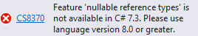

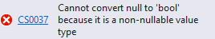
Nullable reference types
1
C# 7.3
Non-nullable value types
Nullable value types
Referente types
Nullable reference types

Slide 92
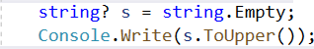

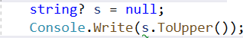

Nullable reference types
2
C# 8.0
Non-nullable reference types
Nullable reference types

Slide 93
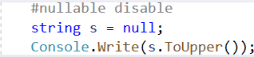
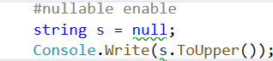
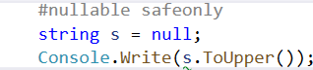
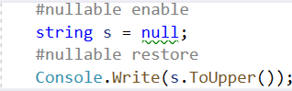
Nullable reference types
3
C# 8.0 - #nullable processor predicate
disable
enable
safeonly
restore

Slide 94
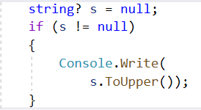
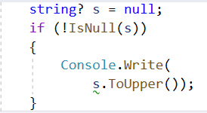
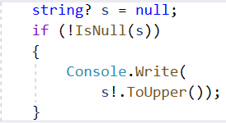
Nullable reference types
4
C# 8.0 – “damn it”/null-forgiving operator
!= operator
IsNull method
Damm-it!

Slide 95
Agenda
We are going to talk about…
What’s new in C# 8.0
Nullable reference types,
async streams,
ranges and indices,
default interface members,
recursive patterns,
switch expressions,
target-typed new-expressions,
extension everything,
using declarations.
What’s new in C# 8.0
Nullable reference types,
async streams,

Slide 96
What’s new in C# 8.0
Async streams

Slide 97
Async streams
1
C# 7.3

Slide 98
Async streams
2
C# 8.0

Slide 99
Agenda
We are going to talk about…
What’s new in C# 8.0
Nullable reference types,
async streams,
ranges and indices,
default interface members,
recursive patterns,
switch expressions,
target-typed new-expressions,
extension everything,
using declarations.
What’s new in C# 8.0
Nullable reference types,
async streams,
ranges and indices,

Slide 100
What’s new in C# 8.0
Ranges and indices

Slide 101



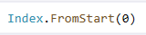

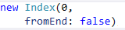
Ranges and indices
1
C# 8.0 – start index
Hello
Word
from
C#
8.0!
This
is
the
indices
feature

Slide 102



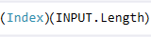



Ranges and indices
2
C# 8.0 – end index
Hello
Word
from
C#
8.0!
This
is
the
indices
feature

Slide 103


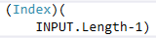



Ranges and indices
3
C# 8.0 – end index
Hello
Word
from
C#
8.0!
This
is
the
indices
feature

Slide 104



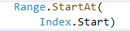

Ranges and indices
4
C# 8.0 – start range
Hello
Word
from
C#
8.0!
This
is
the
range
feature

Slide 105



Ranges and indices
5
C# 8.0 – end range
Hello
Word
from
C#
8.0!
This
is
the
range
feature

Slide 106


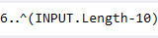


Ranges and indices
6
C# 8.0 - range
Hello
Word
from
C#
8.0!
This
is
the
indices
feature

Slide 107





Ranges and indices
7
C# 8.0 - range
Hello
Word
from
C#
8.0!
This
is
the
indices
feature

Slide 108
Agenda
We are going to talk about…
What’s new in C# 8.0
Nullable reference types,
async streams,
ranges and indices,
default interface members,
recursive patterns,
switch expressions,
target-typed new-expressions,
extension everything,
using declarations.
What’s new in C# 8.0
Nullable reference types,
async streams,
ranges and indices,
default interface members,

Slide 109
What’s new in C# 8.0
Default interface members

Slide 110
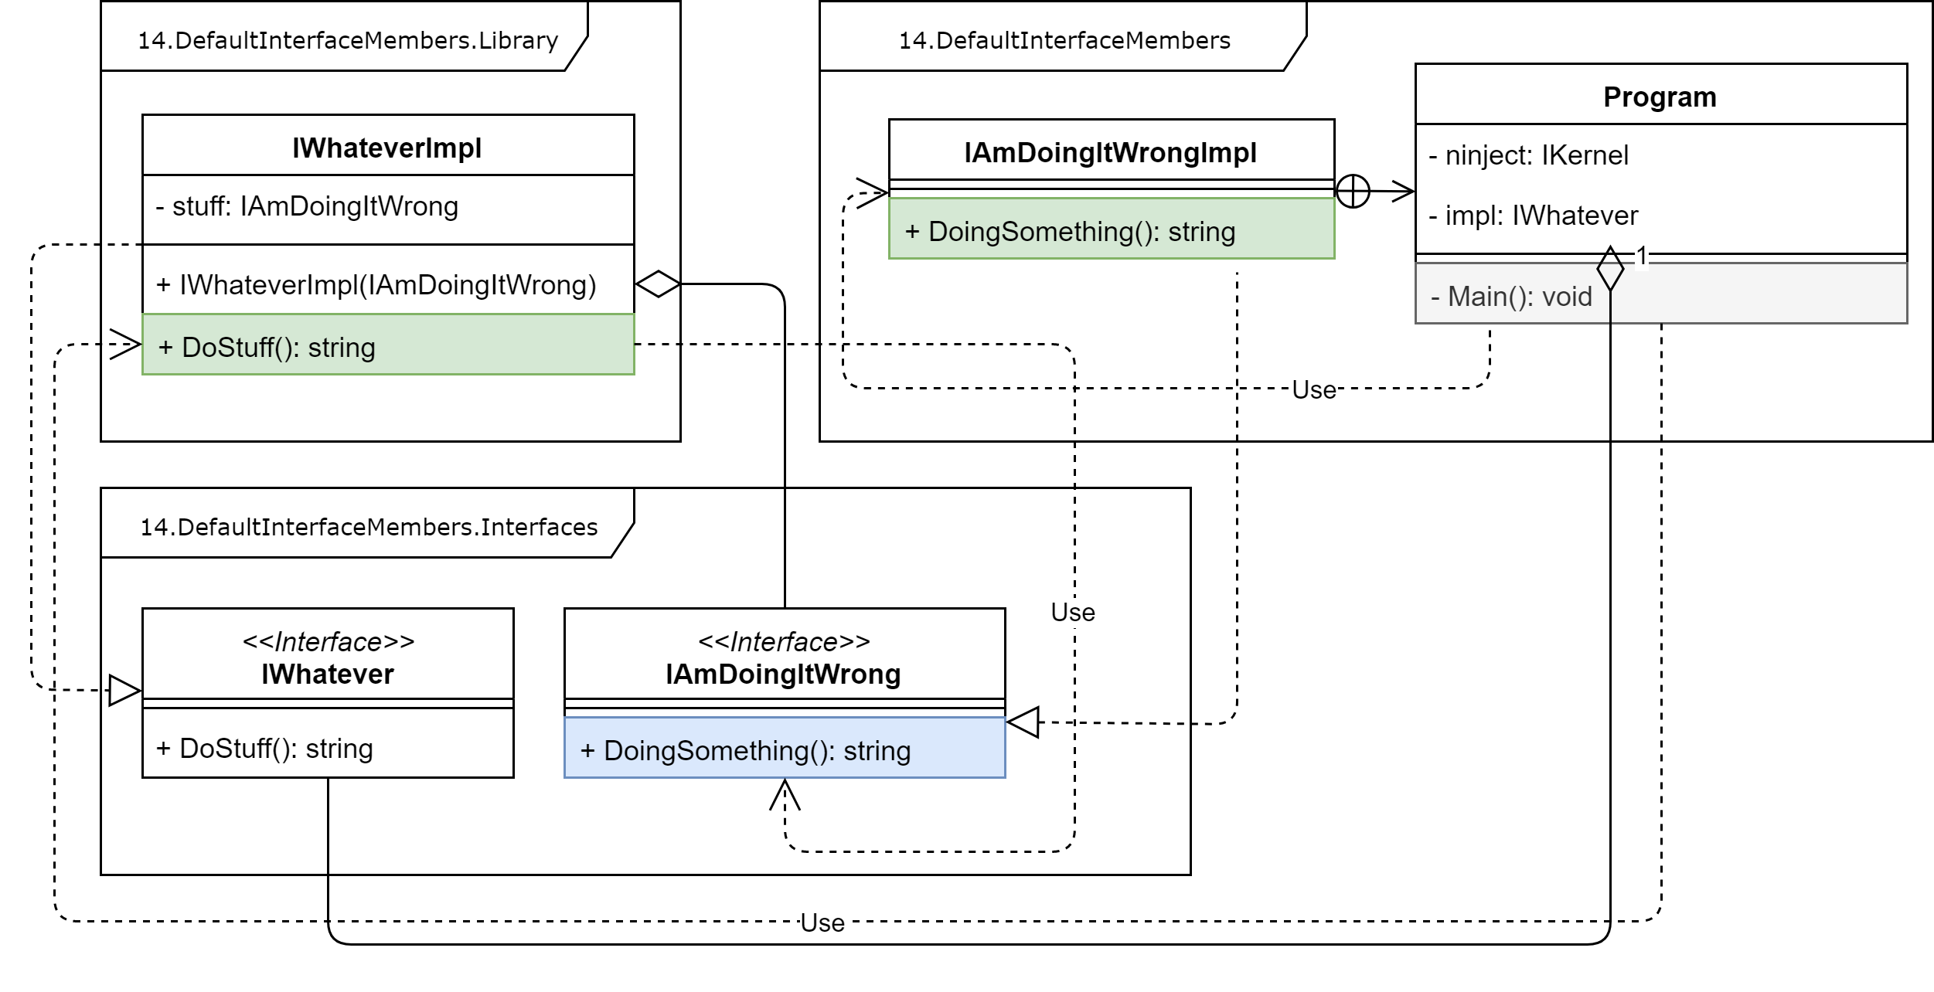
Default interface members
1
C# 7.3 - common interface (old version)

Slide 111
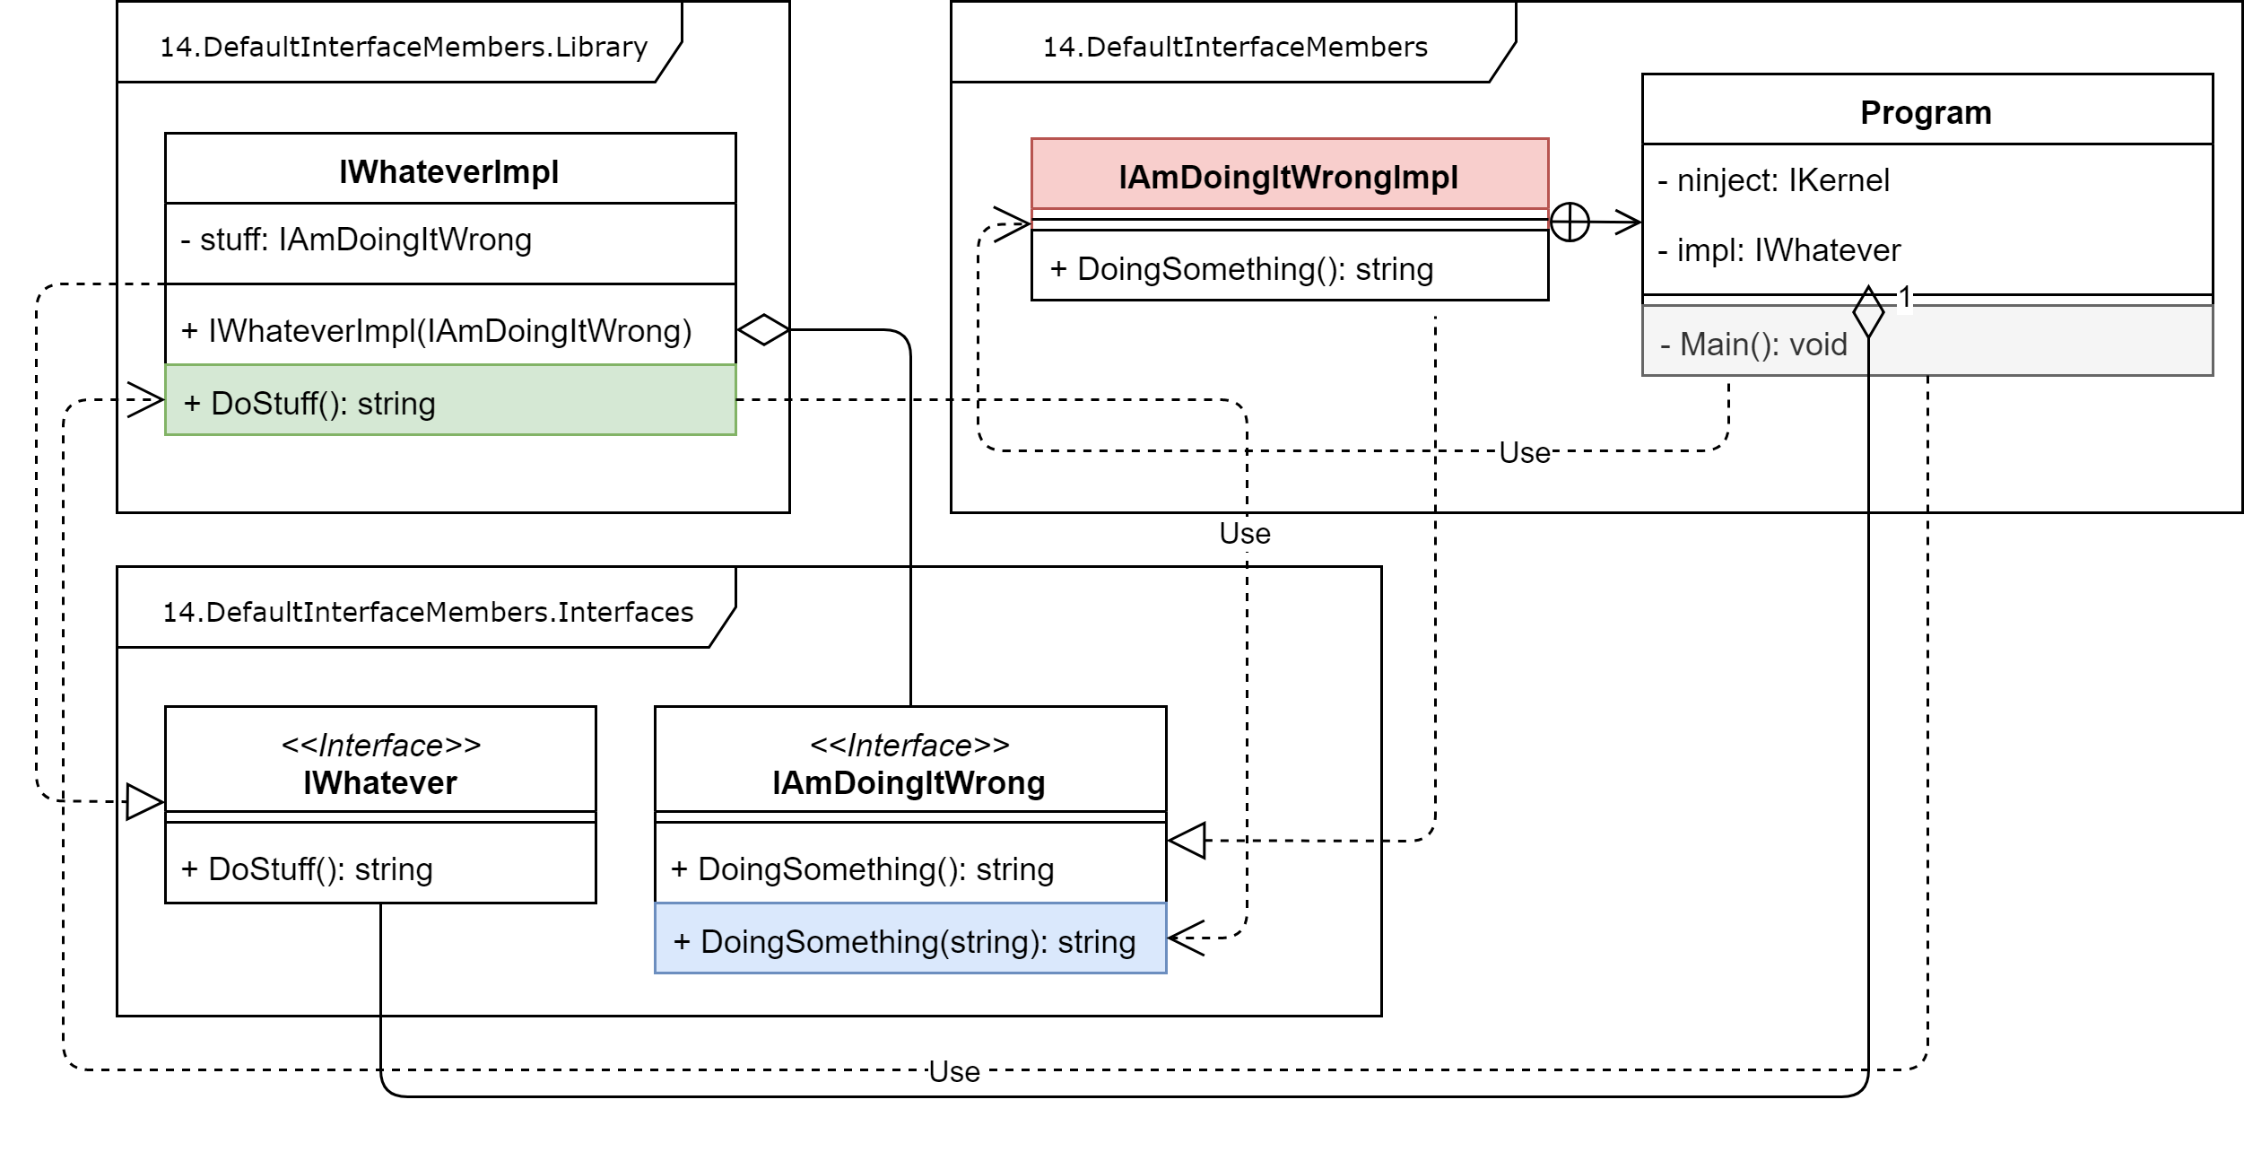
Default interface members
2
C# 7.3 Common interface (compilation error)

Slide 112
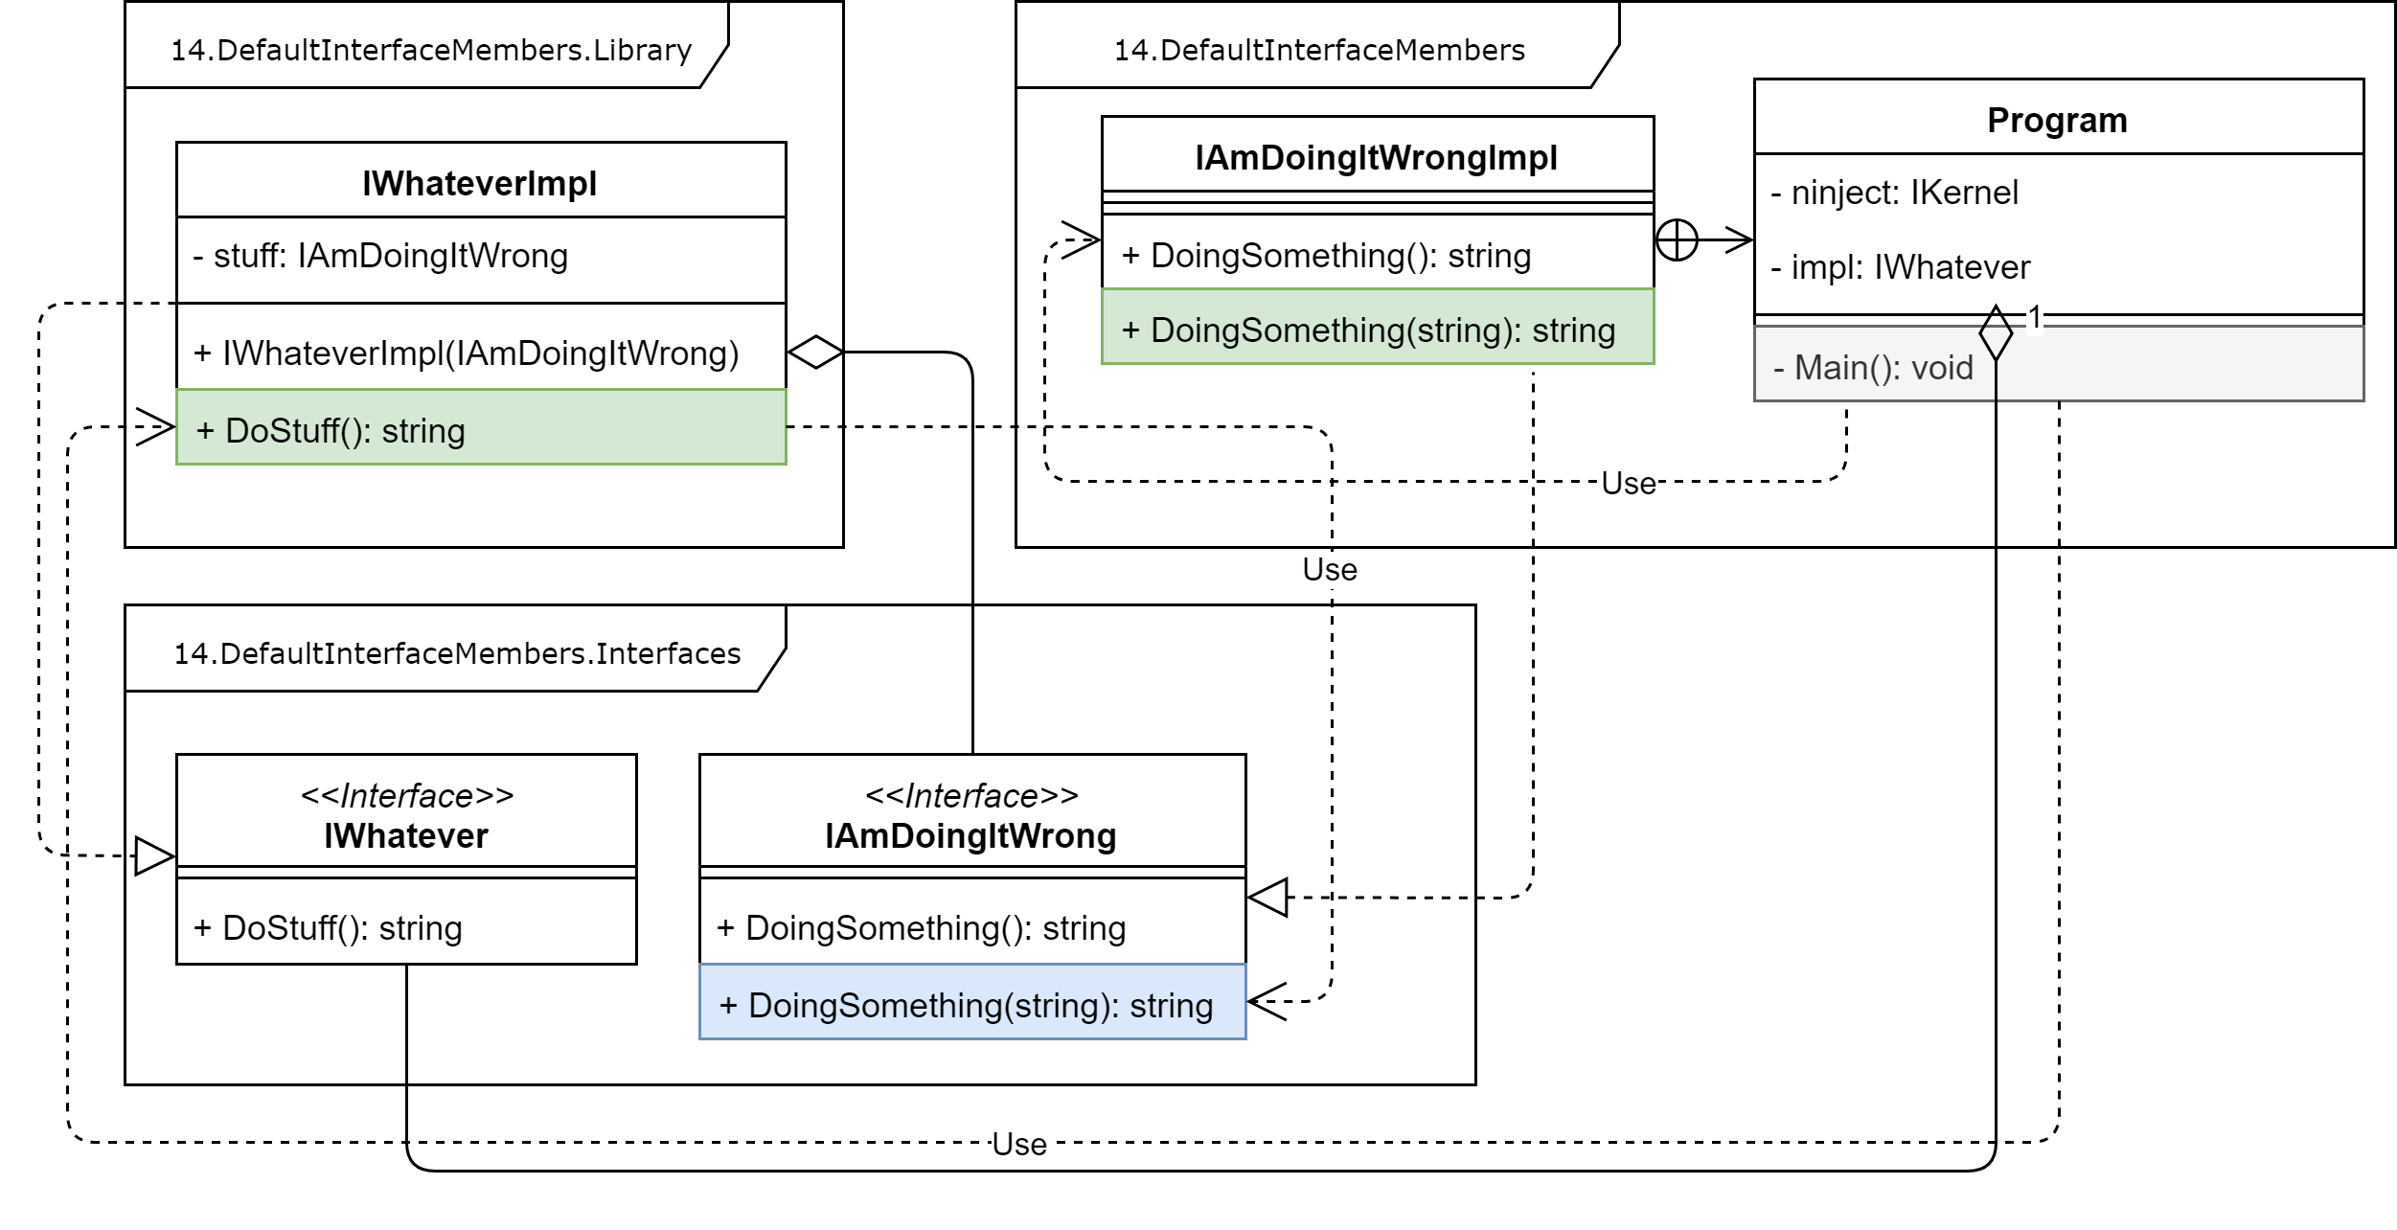
Default interface members
3
C# 7.3 Common interface (new version)

Slide 113
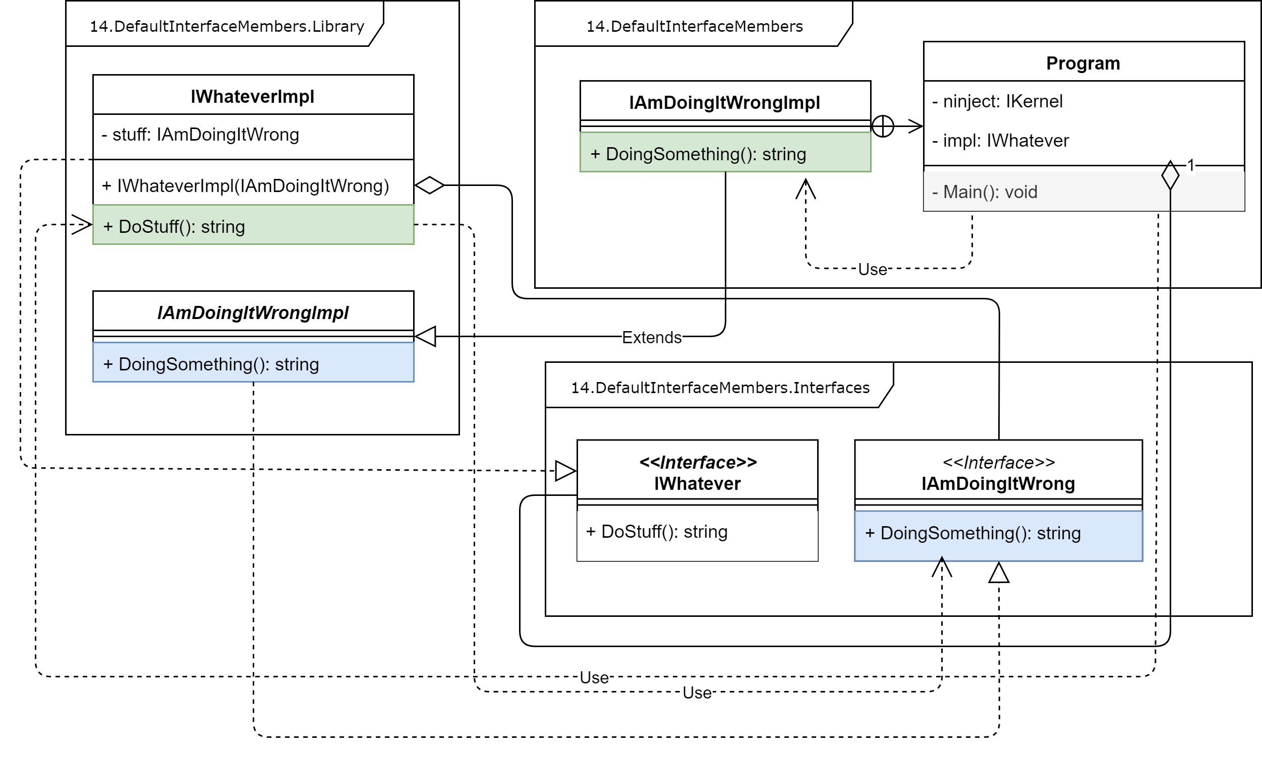
Default interface members
4
C# 7.3 - abstract classes (old version)

Slide 114
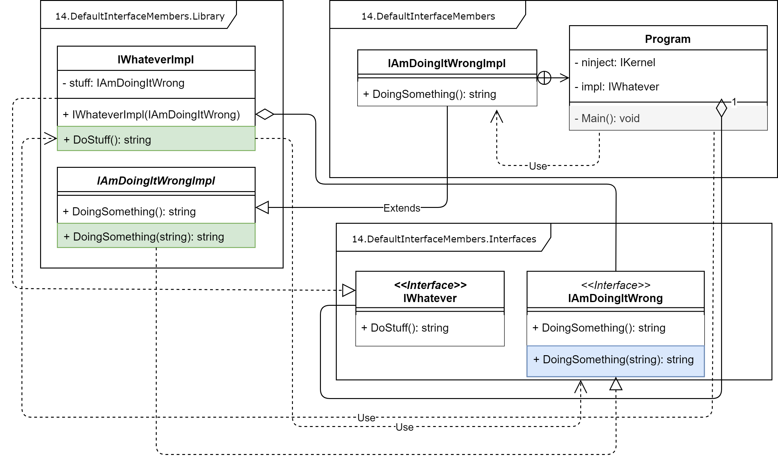
Default interface members
5
C# 7.3 Abstract classes (persists old version)

Slide 115
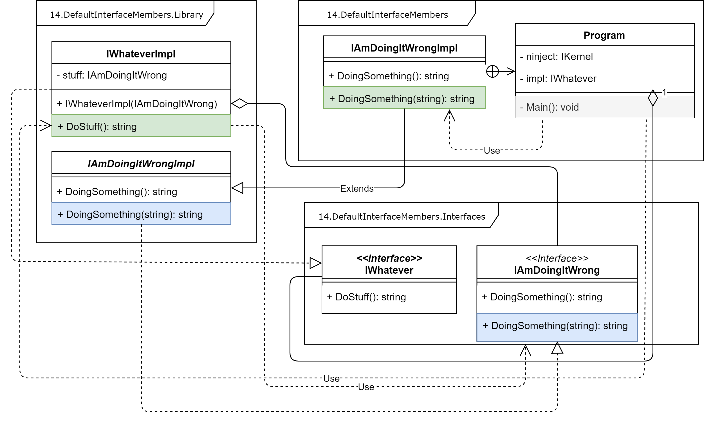
Default interface members
6
C# 7.3 Abstract classes (new version)

Slide 116
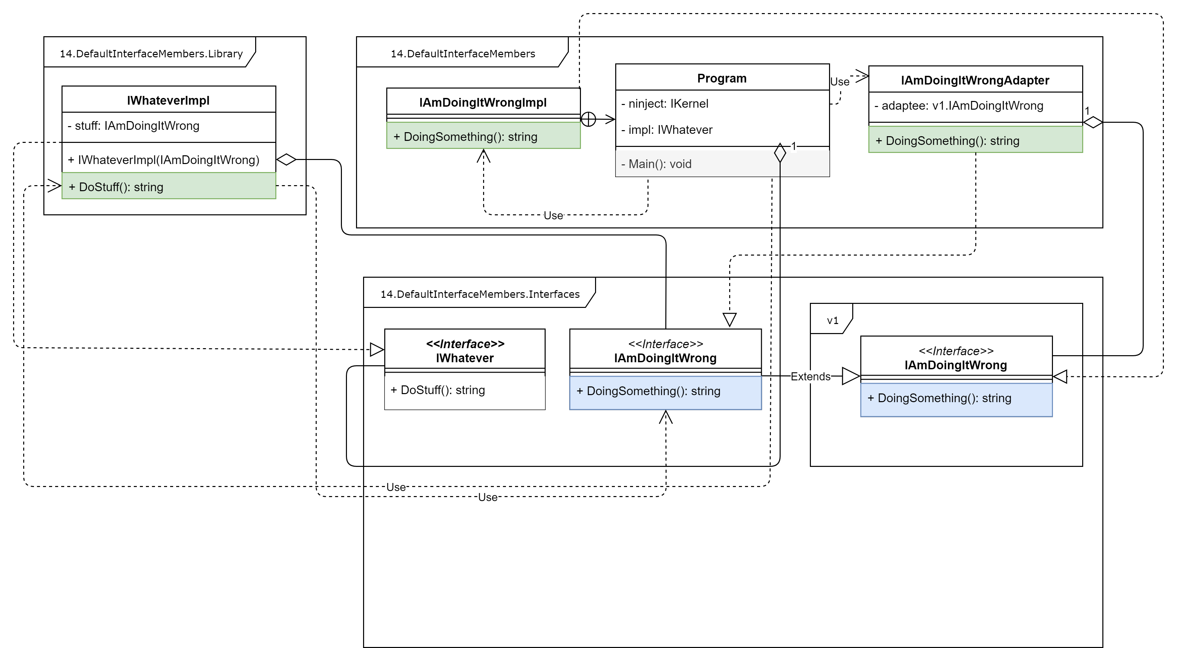
Default interface members
7
C# 7.3 - interface namespaces (old version)

Slide 117
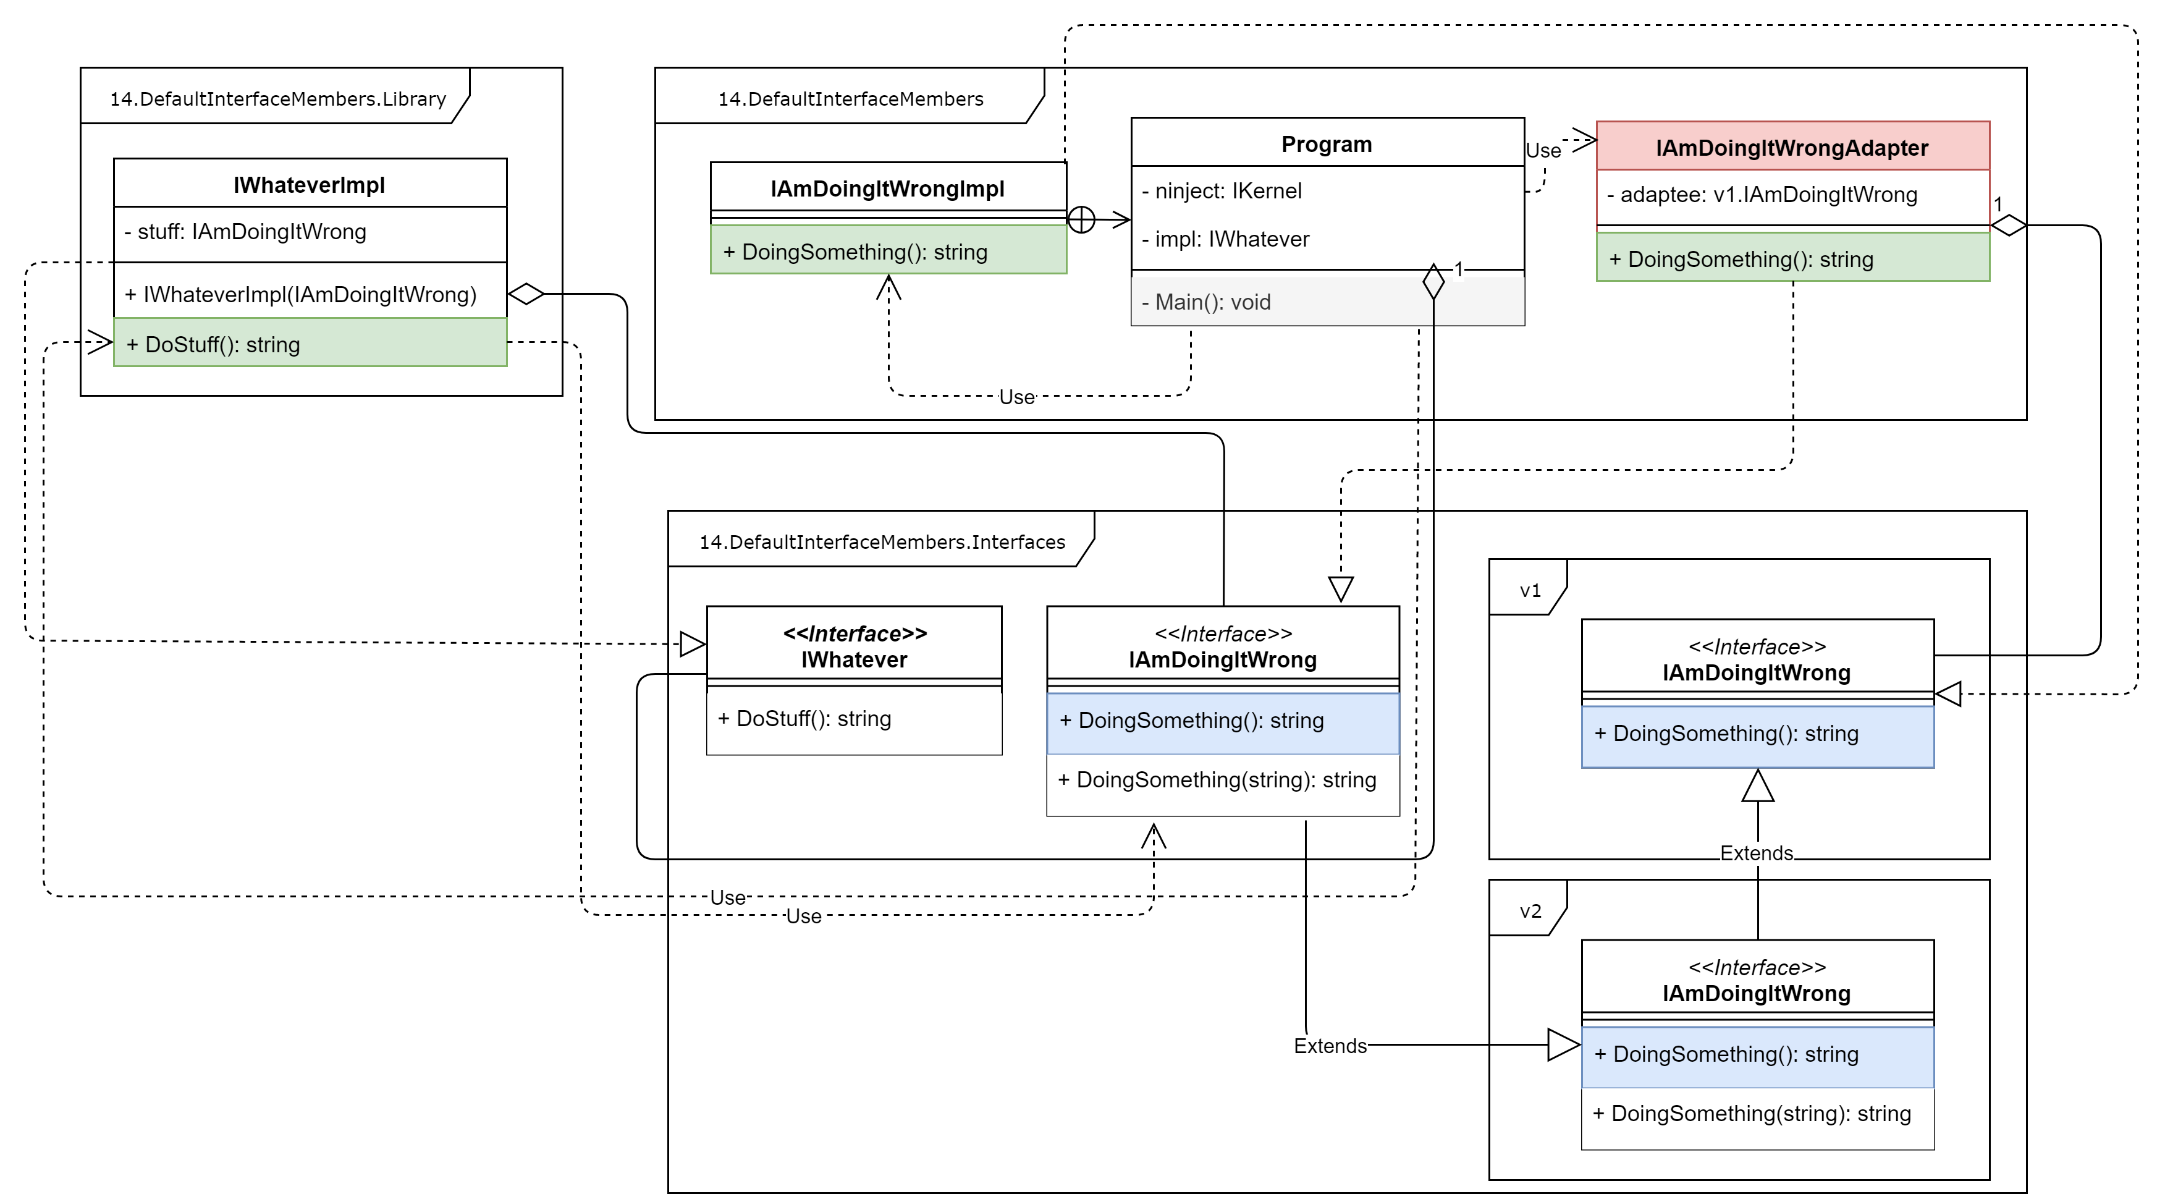
Default interface members
8
C# 7.3 Interface namespaces (compilation error)

Slide 118
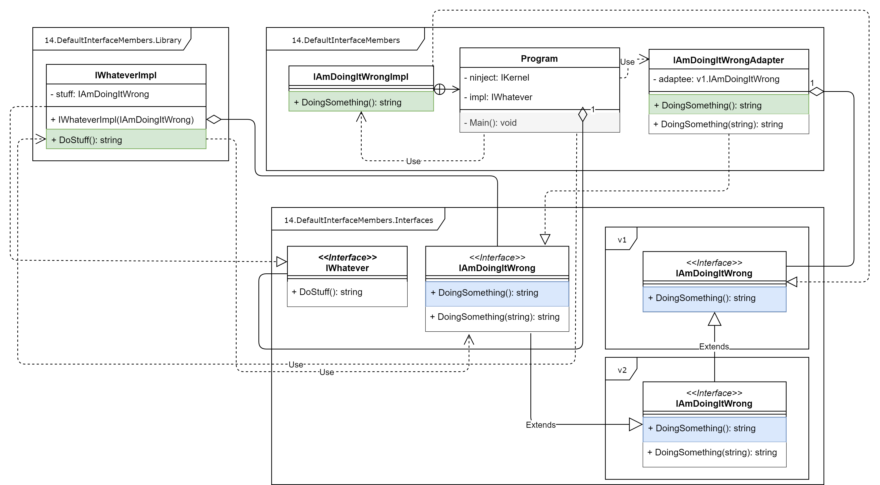
Default interface members
9
C# 7.3 Interface namespaces (persists old version)

Slide 119
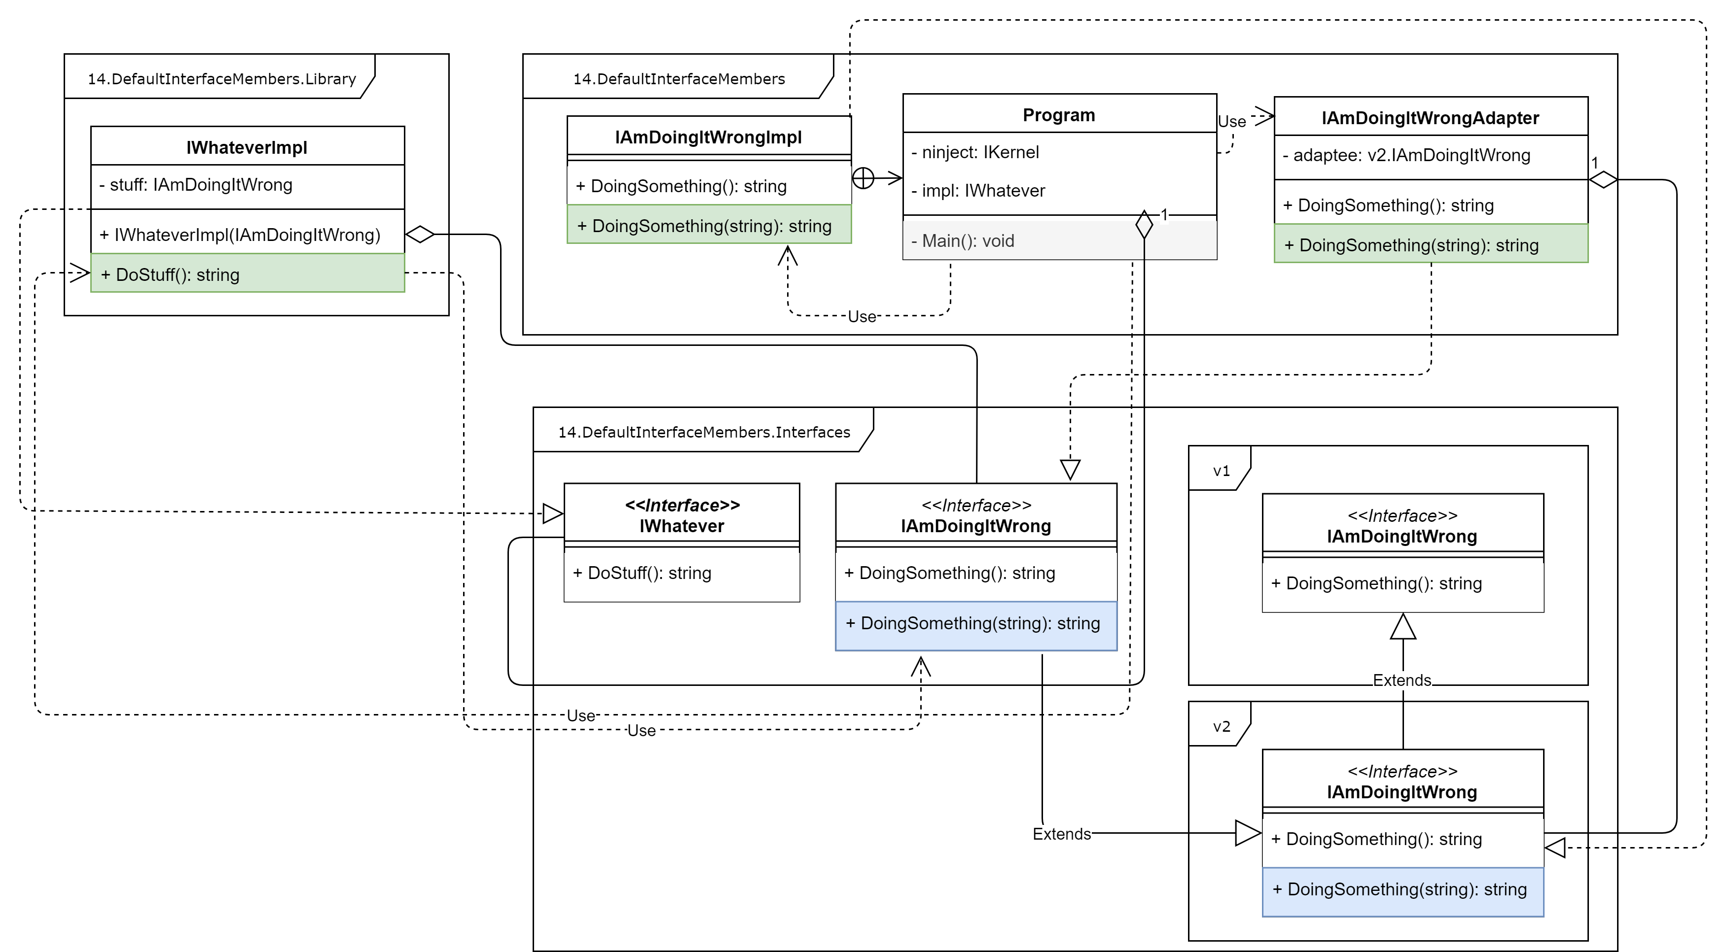
Default interface members
10
C# 7.3 Interface namespaces (new version)

Slide 120

Default interface members
11
C# 8.0 – default interface members implementation (old version)

Slide 121
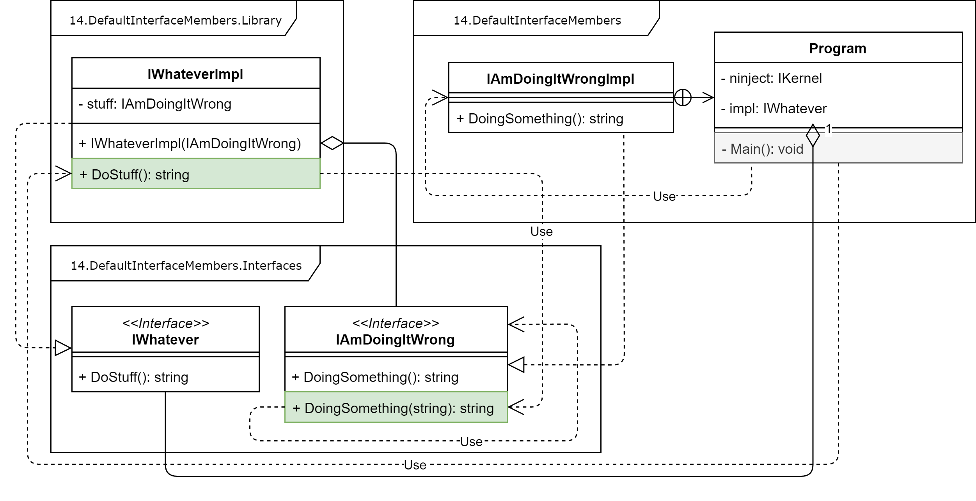
Default interface members
12
C# 8.0 – default interface members implementation (new version)

Slide 122

Default interface members
13
C# 8.0 – default interface members implementation (new version)

Slide 123
Agenda
We are going to talk about…
What’s new in C# 8.0
Nullable reference types,
async streams,
ranges and indices,
default interface members,
recursive patterns,
switch expressions,
target-typed new-expressions,
extension everything,
using declarations.
What’s new in C# 8.0
Nullable reference types,
async streams,
ranges and indices,
default interface members,
recursive patterns,

Slide 124
What’s new in C# 8.0
Recursive patterns
Notes:
https://github.com/dotnet/csharplang/blob/master/proposals/csharp-8.0/patterns.md

Slide 125
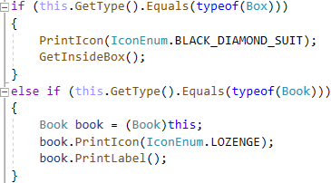
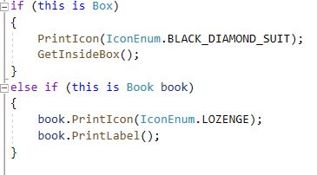
Pattern matching
1
C# 7.0 – is expression
<type>.Equals(<type>)
instance is <type>
Notes:
https://docs.microsoft.com/pl-pl/dotnet/csharp/whats-new/csharp-7#is-expression

Slide 126
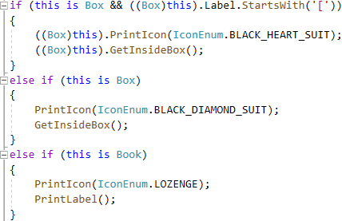
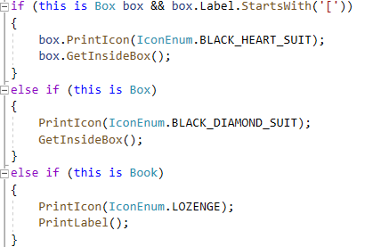
Pattern matching
2
C# 7.0 – is expression
instance is <type>
instance is <type> cast
Notes:
https://docs.microsoft.com/pl-pl/dotnet/csharp/whats-new/csharp-7#is-expression

Slide 127
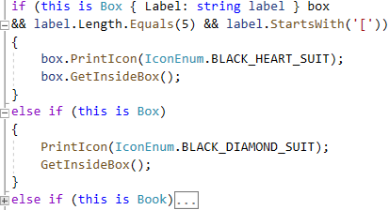
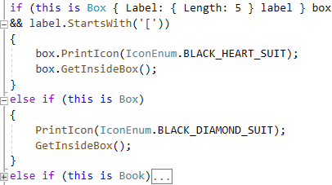
Recursive patterns
3
C# 8.0 – declaration/property/constant pattern
declaration + property pattern
recursive property + constant pattern
Notes:
https://github.com/dotnet/csharplang/blob/master/proposals/csharp-8.0/patterns.md#declaration-pattern
https://github.com/dotnet/csharplang/blob/master/proposals/csharp-8.0/patterns.md#property-pattern
https://github.com/dotnet/csharplang/blob/master/proposals/csharp-8.0/patterns.md#constant-pattern

Slide 128
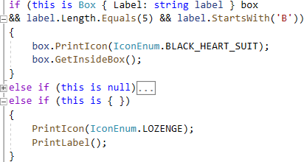
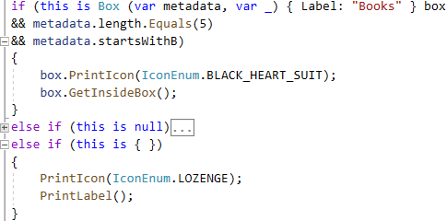
Recursive patterns
4
C# 8.0 – property/designation/positional/discard pattern
null +empty (property) pattern
positional + discard pattern
Notes:
https://github.com/dotnet/csharplang/blob/master/proposals/csharp-8.0/patterns.md#property-pattern
https://github.com/dotnet/csharplang/blob/master/proposals/csharp-8.0/patterns.md#var-pattern
https://github.com/dotnet/csharplang/blob/master/proposals/csharp-8.0/patterns.md#positional-pattern
https://github.com/dotnet/csharplang/blob/master/proposals/csharp-8.0/patterns.md#discard-pattern

Slide 129
Agenda
We are going to talk about…
What’s new in C# 8.0
Nullable reference types,
async streams,
ranges and indices,
default interface members,
recursive patterns,
switch expressions,
target-typed new-expressions,
extension everything,
using declarations.
What’s new in C# 8.0
Nullable reference types,
async streams,
ranges and indices,
default interface members,
recursive patterns,
switch expressions,

Slide 130
What’s new in C# 8.0
Switch expressions

Slide 131
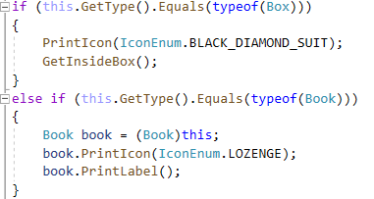
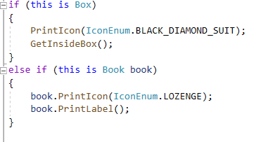
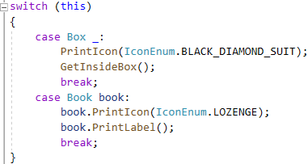
Switch statements
1
C# 7.0
if type of
is type
switch

Slide 132
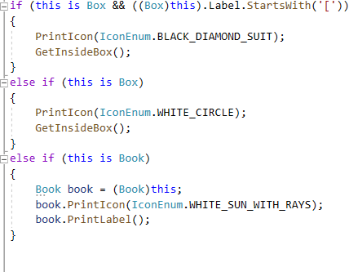


Switch statements
2
C# 7.0 – additional conditions
if condition
case condition
when condition

Slide 133


Switch statements
3
C# 7.0 – null and default cases
if null
case null

Slide 134

Switch statements
4
C# 7.0 – var cases
if null
case var

Slide 135



Switch statements
5
C# 7.0 – var cases
if object
case var when
case var when

Slide 136



Switch expressions
6
C# 8.0
if statement
switch statement
switch expressions

Slide 137


Switch expressions
7
C# 8.0 – property pattern
switch statement
switch expression

Slide 138


Switch expressions
8
C# 8.0 – recurrence property pattern
switch statement
switch expression

Slide 139


Switch expressions
9
C# 8.0 – positional pattern
Positional pattern

Slide 140


Switch expressions
10
C# 8.0 – tuple pattern
if null
case var

Slide 141
Agenda
We are going to talk about…
What’s new in C# 8.0
Nullable reference types,
async streams,
ranges and indices,
default interface members,
recursive patterns,
switch expressions,
target-typed new-expressions,
extension everything,
using declarations.
What’s new in C# 8.0
Nullable reference types,
async streams,
ranges and indices,
default interface members,
recursive patterns,
switch expressions,
target-typed new-expressions,

Slide 142
What’s new in C# 8.0
Target-typed new-expressions

Slide 143

Target-typed new-expressions
1
C# 7.3
Array of arrays

Slide 144

Target-typed new-expressions
1
C# 7.3
Array of arrays

Slide 145
Agenda
We are going to talk about…
What’s new in C# 8.0
Nullable reference types,
async streams,
ranges and indices,
default interface members,
recursive patterns,
switch expressions,
target-typed new-expressions,
extension everything.
What’s new in C# 8.0
Nullable reference types,
async streams,
ranges and indices,
default interface members,
recursive patterns,
switch expressions,
target-typed new-expressions,
extension everything,
using declarations.

Slide 146
What’s new in C# 8.0
Extension everything

Slide 147
Extension everything
1
C# 7.3

Slide 148
Extension everything
2
C# 8.0

Slide 149
Agenda
We are going to talk about…
What’s new in C# 8.0
Nullable reference types,
async streams,
ranges and indices,
default interface members,
recursive patterns,
switch expressions,
target-typed new-expressions,
extension everything,
using declarations.
What’s new in C# 8.0
Nullable reference types,
async streams,
ranges and indices,
default interface members,
recursive patterns,
switch expressions,
target-typed new-expressions,
extension everything,
using declarations.

Slide 150
What’s new in C# 8.0
Using declarations

Slide 151
Using declarations
1
C# 7.3
if null
case var

Slide 152
Using declarations
2
C# 8.0
if null
case var

Slide 155
Title (Work for 1 or 2 lines of title)
Header
Header
Header
Insert bullet point
Insert bullet point
Insert bullet point
Insert bullet point
Insert bullet point
Insert bullet point
Insert bullet point
Insert bullet point
Insert bullet point
Insert bullet point
Insert bullet point
Insert bullet point

Slide 156
Title (Work for 1 or 2 lines of title)
Insert name Insert Title/Role
Insert bullet point
Insert bullet point
Insert bullet point
Insert bullet point
Insert name Insert Title/Role
Insert bullet point
Insert bullet point
Insert bullet point
Insert bullet point
Insert name Insert Title/Role
Insert bullet point
Insert bullet point
Insert bullet point
Insert bullet point
Insert name Insert Title/Role
Insert bullet point
Insert bullet point
Insert bullet point
Insert bullet point

Slide 157
Title (Work for 1 or 2 lines of title)
Insert Group Name
Click to insert bullet point
Click to insert bullet point
Click to insert bullet point
Insert Group Name
Click to insert bullet point
Click to insert bullet point
Click to insert bullet point
Insert Group Name
Click to insert bullet point
Click to insert bullet point
Click to insert bullet point
Group Name
Click to insert text
Click to insert text
Click to insert text
Click to insert text
Click to insert text

